Slide 1
COMPUTER GRAPHICS -introduction, OUTPUT PRIMITIVES & 2-D TRANSFORMATION -Reference Book: Donald Hearn & M. Pauline Baker: Computer Graphics. PHI
Unit -1

Slide 2
Applications of Computer Graphics and Multimedia
Computer-Aided Design (CAD)
Presentation Graphics
Computer Art
Entertainment
Education and Training
Visualization
Image processing
Graphical User Interfaces

Slide 3
Computer Aided Design
For engineering and architectural systems, a major use of computer graphics is in design processes.
CAD methods are used in the design of buildings, automobiles, aircraft, watercraft, space craft, computers, textiles and many other products.
For some design applications, objects are first displayed in a wireframe out-line form, that shows the overall shape and internal features of objects.

Slide 4
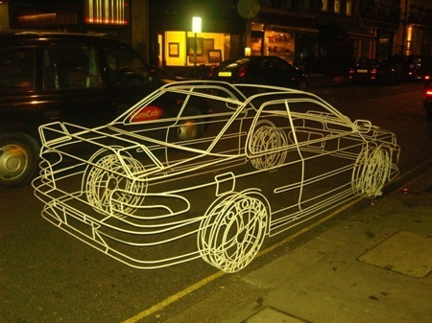
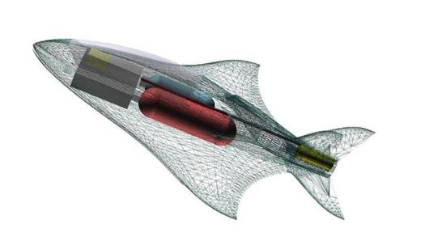
Wireframe display for Automobile
Wireframe display for Aircraft

Slide 5
Circuits and networks for communications, water supply, or other utilities are constructed with repeated placement of a few graphical shapes.
Standard shapes for electrical, electronic, and logic circuits are often supplied by the design package.
Facilities are provided to designer to try out alternate circuit schematics for minimizing the number of components or the space required for the system.
Animations are often used in CAD applications.
Software packages for CAD applications typically provide the designer with a multi-window environment.
Almost in every branch of engineering, the graphics are used in different fashion.

Slide 6
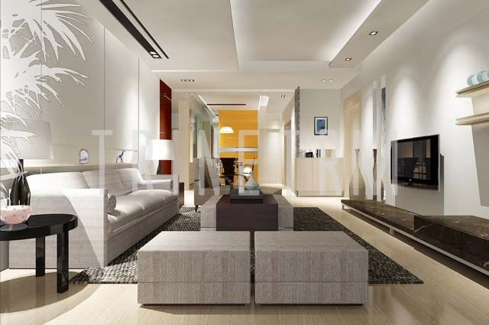

Slide 7
Presentation Graphics
Presentation graphics are used to produce illustrations for reports or to generate slides or transparencies for use with projectors.
They are commonly used to summarize financial, statistical, mathematical, scientific, and economic data for research reports, managerial reports, consumer information bulletins, and other types of reports.
Examples are bar charts, line graphs, surface graphs, pie charts, and other displays showing relationships between multiple parameters.

Slide 8
Computer Arts
Computer graphics methods are widely used in both fine art and commercial art applications.
Artists use special purpose hardware, software packages or programs that allow them to paint pictures on the screen of a video monitor.
The picture is usually painted electronically on a graphics tablet (digitizer) using a stylus, which can simulate different brush strokes, brush widths, and colors.
The stylus translates changing hand pressure into variable line widths, brush sizes, and color gradations.
Computer arts are also used in commercial art for logos and other designs, page layouts combining text and graphics, TV advertising, and other areas.
Morphing is a common graphics method employed in many commercials, where one object is transformed into another.

Slide 9

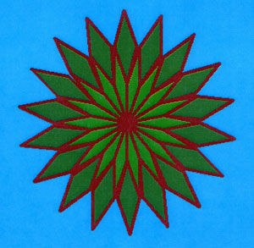
Art design using paint brush
Graphics design using mathematical functions

Slide 10
Entertainment
Computer graphics methods are now commonly used in making motion pictures, music videos, and television shows. Sometimes the graphics scenes are displayed by themselves, and sometimes graphics objects are combined with the actors and live scenes.
The planet and spaceship are drawn in wireframe form and will be shaded with rendering methods to produce solid surfaces.
Many TV series and movies regularly employ computer graphics methods.
Music videos use graphics in several ways. Graphics objects can be combined with the live action, or graphics and image processing techniques can be used to produce a transformation of one person or object into another (morphing).

Slide 11
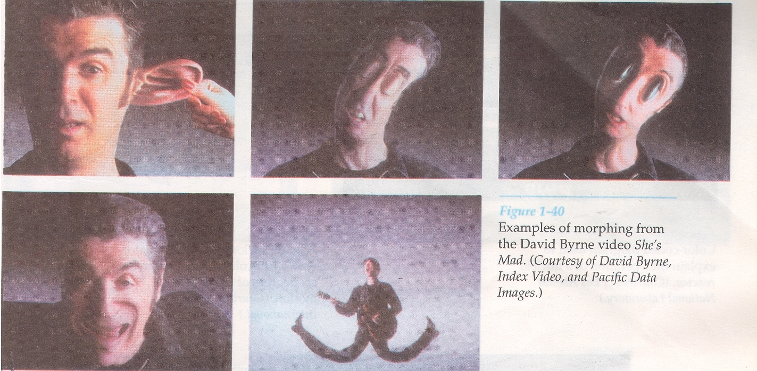

Slide 12
Education and Training
Computer-generated models of physical, financial, and economic systems are often used as educational aids.
Models can help trainees to understand the operation of the system.
For some training applications, special systems are designed. For example, the simulators for practice session or training of ship captains, aircraft pilots, heavy-equipment operators, and air traffic control personnel.
Most simulators provide graphics screens for visual operation.

Slide 13
Visualization
Scientists, business analysts or some people who often need to analyze large amounts of information or to study the behavior of certain process are benefited by graphics.
Numerical simulations carried out on supercomputers frequently produce data files containing thousands and even millions of data values.
Scanning these large sets of numbers to determine trends and relationships is a tedious and ineffective process. But if the data are converted to a visual form, the trends and patterns are often immediately apparent.

Slide 14
Image Processing
In computer graphics, a computer is used to create a picture. Image processing, on the other hand, applies techniques to modify or interpret existing pictures, such as photographs and TV scans.
Principal applications of image processing are
Improving picture quality and
Machine perception of visual information

Slide 15
Graphical User Interfaces
It is common now for software packages to provide a graphical interface. A major component of a graphical interface is a window manager that allows a user to display multiple-window areas. Each window can contain a different process that can contain graphical or nongraphical displays. To make a particular window active, we simply click in that window using an interactive pointing device.
Interfaces also display menus and icons for fast selection of processing options or parameter values. An icon is a graphical symbol that is designed to look like the processing option it represents. The advantages of icons are that they take up less screen space than corresponding textual descriptions and they can be understood more quickly if well designed. Menus contain lists of textual descriptions and icons.
Normally, a typical graphical interface contains a window manager, menu displays, and icons. The menus allow selection of processing options, color values, and graphics parameters. The icons represent options for painting, drawing, zooming, typing text strings, and other operations connected with picture construction as shown in figure on next slide:

Slide 16
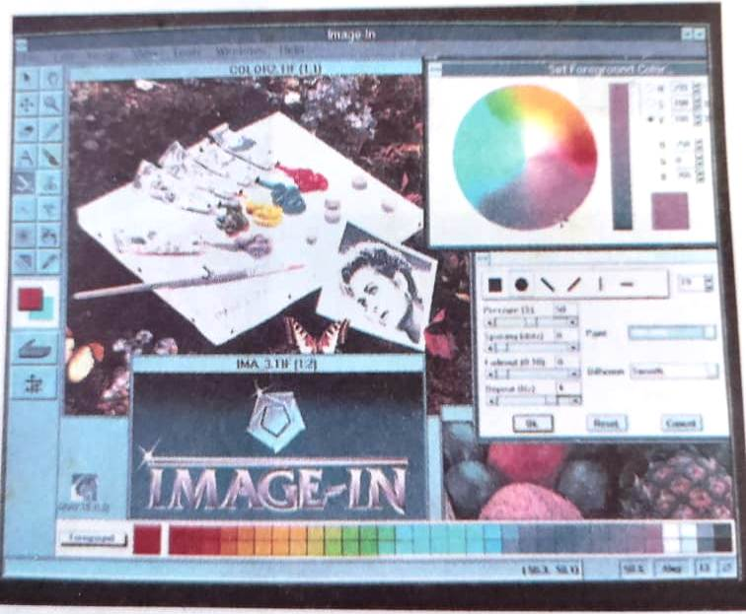

Slide 17

Example of VFX (Visual Effects)

Slide 18
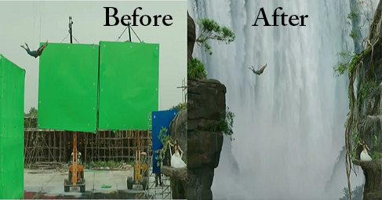
Example of VFX (Visual Effects)

Slide 19
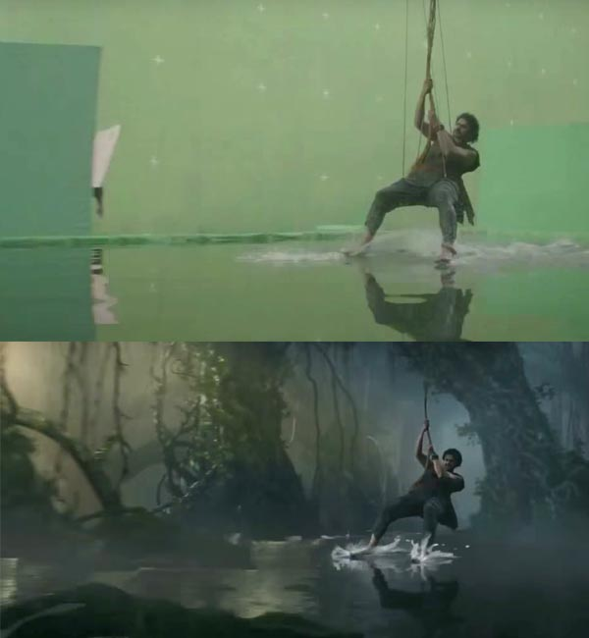
Example of VFX (Visual Effects)

Slide 20
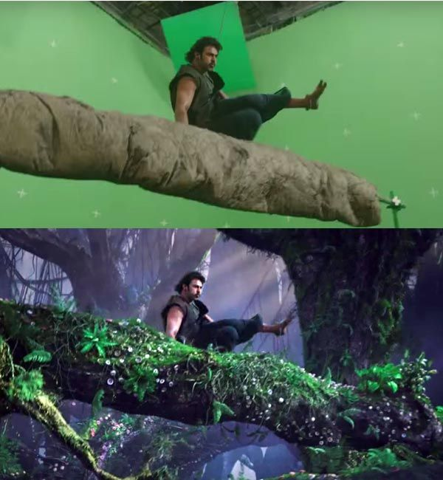
Example of VFX (Visual Effects)

Slide 21
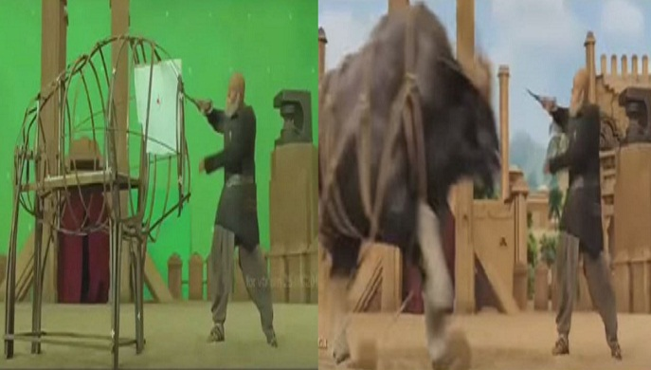
Example of VFX (Visual Effects)

Slide 22
Graphics Software
There are two general classifications of graphics software: (i) General programming packages and (ii) Special-purpose application packages.
General programming package provides an extensive set of graphics functions that can be used in a high-level programming language, such as C or FORTRAN. Example of a general graphics programming package is the GL(Graphics Library).
Application graphics packages are designed for nonprogrammers, so that users can generate displays without worrying about how graphics operations work. Examples of such applications packages are the artist’s painting programs, CAD systems, medical applications etc.

Slide 23
Software Standards 1.Graphical Kernel System (GKS)
GKS was the first ISO standard for low-level computer graphics, introduced in 1977.
GKS provides a set of drawing features for two-dimensional vector graphics suitable for charting and similar duties.
The calls are designed to be portable across different programming languages, graphics devices and hardware, so that applications written to use GKS will be readily portable to many platforms and devices.
Next version of GKS supported 3D pictures.
A descendant of GKS was PHIGS.

Slide 24
2.PHIGS
PHIGS (Programmer's Hierarchical Interactive Graphics System) is an API standard for rendering 3D computer graphics.
PHIGS was designed in the 1980s, inheriting many of its ideas from the Graphical Kernel System of the late 1970s.
It include some extra features like color specification, picture manipulation, surface rendering etc.
It provide basic graphics function, but it does not specify any standard method to interface with devices.
It does not support any method to store and transmission of images.
Next version is PHIGS+. It include 3D surface shading capability.

Slide 25
To overcome the limitations of PHIGS, separate standards have been developed.
Standardization for device interface methods is given in the Computer Graphics Interface (CGI) system and the Computer Graphics Metafile (CGM) system specifies standards for archiving and transporting pictures.

Slide 26
3. OpenGL
OpenGL (Open Graphics Library) is a standard specification defining a cross-language, cross-platform API for writing applications that produce 2D and 3D computer graphics.
The interface consists of over 250 different function calls which can be used to draw complex three-dimensional scenes from simple primitives.
OpenGL's basic operation is to accept primitives such as points, lines and polygons, and convert them into pixels.
OpenGL's "low-level" API allowed the programmer to make dramatic improvements in rendering performance by first examining the data on the CPU-side before trying to send it over the bus to the graphics engine. For instance, the programmer could "cull" the objects by examining which objects were actually visible in the scene, and sending only those objects that would actually end up on the screen. This was kept private in PHIGS, making it much more difficult to tune performance.

Slide 27
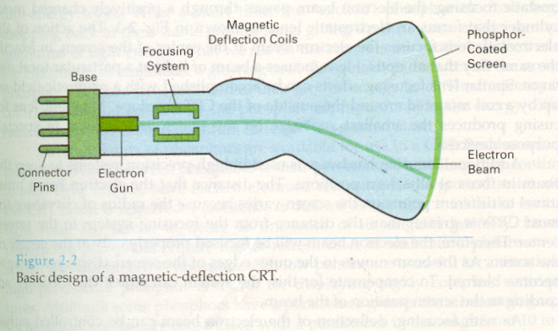
Video Display Devices
The primary output device in a graphics system is a video monitor.
The operation of most video monitors is based on the standard cathode-ray tube (CRT).

Slide 28
Refresh Cathode-Ray Tubes:
The Figure illustrates the basic operation of a CRT. A beam of electrons (cathode rays), emitted by an electron gun, passes through focusing and deflection systems that direct the beam toward specified positions on the phosphor-coated screen.
The phosphor then emits a small spot of light at each position contacted by the electron beam. Because the light emitted by the phosphor fades very rapidly, some method is needed for maintaining the screen picture. One way to keep the phosphor glowing is to redraw the picture repeatedly by quickly directing the electron beam back over the same points. This type of display is called a refresh CRT.

Slide 29
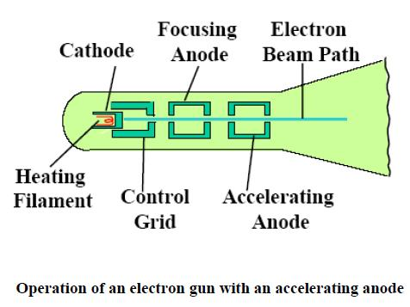
The primary components of an electron gun in a CRT are the heated metal cathode and a control grid (above Fig. ). Heat is supplied to the cathode by directing a current through a coil of wire, called the filament, inside the cylindrical cathode structure. This causes electrons to be “boiled off" the hot cathode surface. In the vacuum inside the CRT envelope, the free, negatively charged electrons are then accelerated toward the phosphor coating by a high positive voltage. The accelerating voltage can be generated with a positively charged metal coating on the in side of the CRT envelope near the phosphor screen, or an accelerating anode can be used.

Slide 30
The distance that the electron beam must travel to different points on the screen varies because the radius of curvature for most CRTs is greater than the distance from the focusing system to the screen center. Therefore, the electron beam will be focused properly only at the center of the screen. As the beam moves to the outer edges of the screen, displayed images become blurred. To compensate for this, the system can adjust the focusing according to the screen position of the beam.
The frequency (or color) of the light emitted by the phosphor is proportional to the energy difference between the excited quantum state and the ground state.
Different kinds of phosphors are available for use in a CRT. Besides color, a major difference between phosphors is their persistence: how long they continue to emit light (that is, have excited electrons returning to the ground state) after the CRT beam is removed. Persistence is defined as the time it takes the emitted light from the screen to decay to one-tenth of its original intensity.

Slide 31
Lower persistence phosphors require higher refresh rates to maintain a picture on the screen without flicker (Flickering is the display of one image over the top of another in rapid succession). A phosphor with low persistence is useful for animation; a high-persistence phosphor is useful for displaying highly complex, static pictures.
Although some phosphors have a persistence greater than 1 second, graphics monitors are usually constructed with a persistence in the range from 10 to 60 microseconds.
The maximum number of points that can be displayed without overlap on a CRT is referred to as the resolution. A more precise definition of resolution is the number of points per centimeter that can be plotted horizontally and vertically, although it is often simply stated as the total number of points in each direction.

Slide 32
The resolution of a CRT is dependent on the type of phosphor, the intensity to be displayed, and the focusing and deflection systems. Typical resolution on high-quality systems is 1280 by 1024, with higher resolutions available on many systems. High resolution systems are often referred to as high-definition systems. The physical size of a graphics monitor is given as the length of the screen diagonal, with sizes varying from about 12 inches to 27 inches or more. A CRT monitor can be attached to a variety of computer systems, so the number of screen points that can actually be plotted depends on the capabilities of the system to which it is attached.
Another property of video monitors is aspect ratio. This number gives the ratio of vertical points to horizontal points necessary to produce equal-length lines in both directions on the screen. (Sometimes aspect ratio is stated in terms of the ratio of horizontal to vertical points.) An aspect ratio of 3/4 means that a vertical line plotted with three points has the same length as a horizontal line plotted with four points.

Slide 33
Raster-Scan Displays
The most common type of graphics monitor employing a CRT is the raster scan display, based on television technology.
In raster scan system, the electron beam is swept across the screen, one row at a time from top to bottom.
As the electron beam moves across each row, the beam intensity is turned on and off to create a pattern of illuminated spots.
Picture definition is stored in memory area called the refresh buffer or frame buffer.
This memory area holds the set of intensity values for all the screen points. Stored intensity values are then retrieved from the refresh buffer and “painted” on the screen one row(scan line) at a time.
Each screen point is referred to as a pixel or pel (picture element).

Slide 34
Intensity range for pixel positions depends on the capability of the raster system.
In a simple black and white system, each screen point is either on or off, so only one bit per pixel is needed to control the intensity of screen positions.
Bit value of 1 indicates that the electron beam is to be turned on at that position, and a value of 0 indicates that the beam intensity is off.
On a black and white system with one bit per pixel, the frame buffer is commonly called a bitmap.
Additional bits are needed when color and intensity variations can be displayed (up to 24 bits per pixel).
A system with 24 bits per pixel and a screen resolution of 1024 by 1024 requires 3 MB of storage for frame buffer.
For systems with multiple bits per pixel, the frame buffer is often referred to as a pixmap.

Slide 35
Refreshing on raster scan displays is carried out at the rate of 60 to 80 frames per second or higher.
Refresh rates are described in units of cycle per second, or Hertz (Hz), where cycle correspond to one frame ( i.e 60 Hz).
At the end of each scan line, the electron beam returns to the left side of the screen to begin displaying the next scan line.
The return to the left of the screen, after refreshing each scan line, is called the horizontal retrace of the electron beam. And at the end of each frame, the electron beam returns to the top left corner of the screen to begin the next frame is called vertical retrace.

Slide 36
On some raster-scan systems (and in TV sets), each frame is displayed in two passes using an interlaced refresh procedure. In the first pass, the beam sweeps across every other scan line from top to bottom. Then after the vertical retrace, the beam sweeps out the remaining scan lines. Interlacing of the scan lines in this way allows us to see the entire screen displayed in one-half the time it would have taken to sweep across all the lines at once from top to bottom.
Interlacing is primarily used with slower refreshing rates. On an older, 30 frame per second, non interlaced display, for instance, some flicker is noticeable. But with interlacing, each of the two passes can be accomplished in 1/60th of a second, which brings the refresh rate nearer to 60 frames per second. This is an effective technique for avoiding flicker, providing that adjacent scan lines contain similar display information.

Slide 37
Random Scan Display
When operated as a random scan display unit, a CRT has the electron beam directed only to the parts of the screen where a picture is to be drawn.
Random scan monitors draw a picture one line at a time and for this reason are also referred to as vector displays or stroke-writing or calligraphic displays.
The component lines of a picture can be drawn and refreshed by a random-scan system in any specified order.
Refresh rate on a random scan system depends on the number of lines to be displayed.
Picture definition is now stored as a set of line drawing commands in an area of memory referred to as the refresh display file. Sometimes it is also called the display list, display program, or simply refresh buffer.

Slide 38
To display a specified picture, the system cycles through the set of commands in the display file, drawing each component line in turn.
After all line drawing commands have been processed, the system cycles back to the first line command in the list.
Random scan displays are designed to draw all the component lines of a picture 30 to 60 times each second.
When a small set of lines is to be displayed, each refresh cycle is delayed to avoid refresh rates greater than 60 frames per second. Otherwise, faster refreshing of the set of lines could burn out the phosphor.

Slide 39
Random-Scan Systems v/s Raster-Scan Systems
Random scan systems are designed for line drawing applications and cannot display realistic shaded scenes as Raster scan systems.
Since picture definition is stored as a set of line-drawing instructions and not as a set of intensity values for all screen points, vector displays generally have higher resolution than raster systems.
Vector displays produce smooth line drawings because the CRT beam directly follows the line path. A raster system in contrast, produces jagged lines that are plotted as discrete point sets.

Slide 40
Color CRT Monitors
A CRT monitor displays color pictures by using a combination of phosphors that emit different-colored light.
By combining the emitted light from the different phosphors, a range of colors can be generated.
The two basic techniques for producing colors in CRT are the beam penetration method and the shadow-mask method.

Slide 41
Beam penetration method
This method for displaying color pictures has been used with random scan monitors.
Two layers of phosphor, usually red and green, are coated onto the inside of the CRT screen, and the displayed color depends on how far the electron beam penetrates into the phosphor layers.
A beam of slow electrons excites only the outer red layer.
A beam of very fast electrons penetrates through the red layer and excites the inner green layer.
At intermediate beam speeds, combinations of red and green light are emitted to show two additional colors, orange and yellow.
The speed of the electrons, and hence the screen color at any point, is controlled by the beam-acceleration voltage.
This method is inexpensive, but produces only four colors. Quality of picture is not good as other methods.

Slide 42
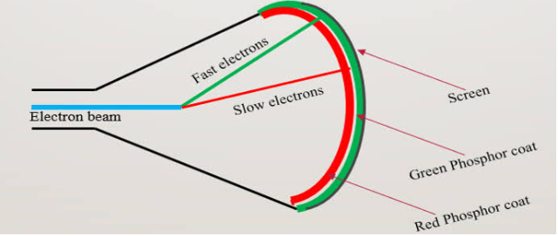
Beam penetration method

Slide 43
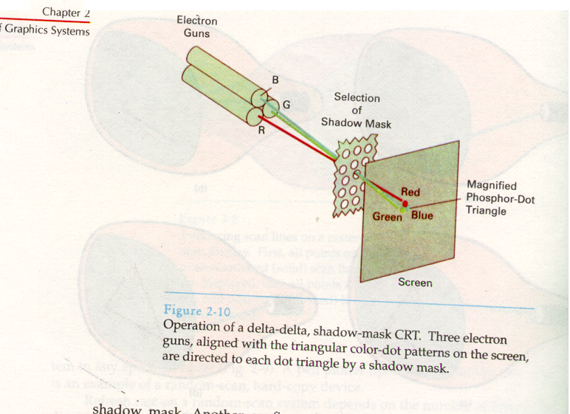
Shadow Mask method

Slide 44
Shadow-mask methods are commonly used in raster-scan systems because they produce a much wider range of colors than the beam penetration method .
A shadow mask CRT has three phosphor color dots at each pixel position.
One phosphor dot emits a red light, another emits a green light, and the third emits a blue light.
This type of CRT has three electron guns, one for each color dot, and a shadow mask grid just behind the phosphor coated screen.
Figure shows the delta-delta shadow-mask method, commonly used in color CRT systems.
Three electron beams are deflected and focused as a group onto the shadow mask, which contains a series of holes aligned with the phosphor-dot patterns.
When the three beams pass through a hole in the shadow mask, they activate a dot triangle, which appears as a small color spot on the screen.

Slide 45
The phosphor dots in the triangles are arranged so that each electron beam can activate only its corresponding color dot when it passes through the shadow mask.
Another configuration for the three electron guns is an in-line arrangement in which the three electron guns, and the corresponding red-green-blue dots on the screen, are aligned along one scan line instead of in a triangular pattern.
This in-line arrangement of electron guns is easier to keep in alignment and is commonly used in high-resolution color CRTs.
We obtain color variations in shadow-mask CRT by varying the intensity levels of the three electron beams.
By turning off the red and green guns, we get only the color coming from the blue phosphor. Likewise, we can get different colors.

Slide 46
Color CRTs in graphics systems are designed as RGB monitors.
These monitors use shadow mask methods and take the intensity level for each electron gun directly from the computer system without any intermediate processing.
High quality raster graphics systems have 24 bits per pixel in the frame buffer, allowing 256 voltage settings for each electron gun and nearly 17 million color choices for each pixel.
An RGB color system with 24 bits of storage per pixel is generally referred to as a full-color system or true-color system.

Slide 47
Direct-View Storage Tubes :
An alternative method for maintaining a screen image is to store the picture information inside the CRT instead of refreshing the screen. A direct-view storage tube (DVST) stores the picture information as a charge distribution just behind the phosphor-coated screen. Two electron guns are used in a DVST. One, the primary gun, is used to store the picture pattern; the second, the flood gun, maintains the picture display.

Slide 48
Flat-Panel Displays:
Although most graphics monitors are still constructed with CRTs, other technologies are emerging that may soon replace CRT monitors. The term Flat-panel display refers to a class of video devices that have reduced volume, weight, and power requirements compared to a CRT. A significant feature of flat-panel displays is that they are thinner than CRTs, and we can hang them on walls or wear them on our wrists. Since we can even write on some flat-panel displays, they will soon be available as pocket notepads. Current uses for flat-panel displays include TV monitors, calculators, pocket video games, laptop computers, armrest viewing of movies on airlines, as advertisement boards in elevators, and as graphics displays in applications requiring rugged, portable monitors.

Slide 49
Another type of emissive device is the light-emitting diode (LED). A matrix of diodes is arranged to form the pixel positions in the display, and picture definition is stored in a refresh buffer. As in scan-line refreshing is read from the refresh buffer and converted to voltage levels that are applied to the diodes to produce the light patterns in the display.
Liquid-Crystal Displays (LCDs) are commonly used in small systems, such as calculators and portable, laptop computers. These non-emissive devices produce a picture by passing polarized light from the surrounding or from an internal light source through a liquid-crystal material that can be aligned to either block or transmit the light.

Slide 50
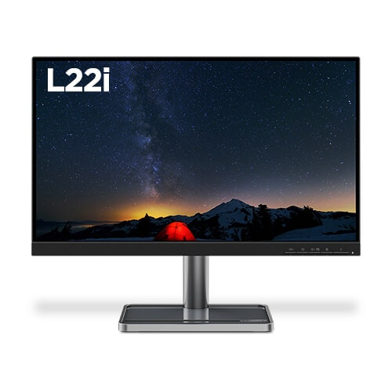
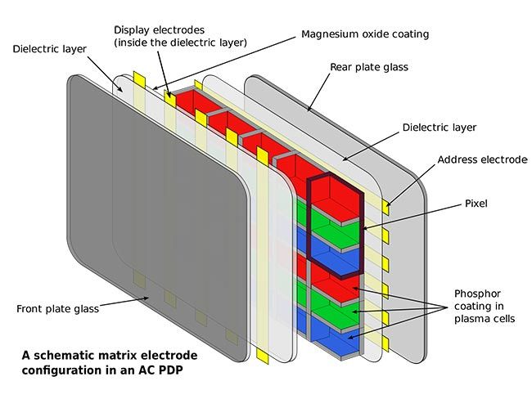
LED Monitor

Slide 51
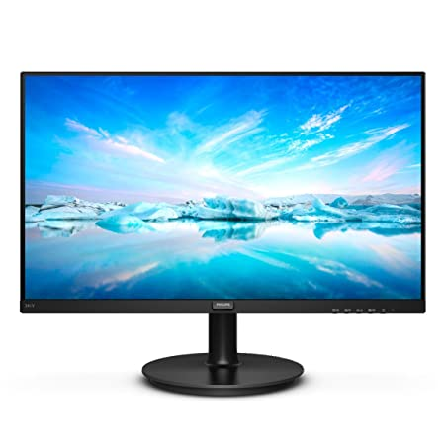
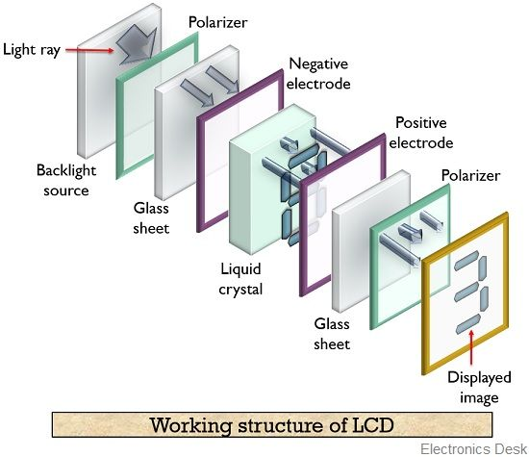
LCD Monitor

Slide 52
Coordinate Representations
Graphics packages require coordinate specifications to be given with respect to Cartesian reference frames.
Several different Cartesian reference frames are used to construct and display a scene.
We can construct the shape of individual objects in a scene within separate coordinate reference frames called Modeling coordinates OR Local Coordinates OR Master coordinates.
Once individual objects shapes have been specified, we can place the objects into appropriate positions within the scene using a reference frame called World Coordinates .

Slide 53
Finally, the world-coordinate description of the scene is transferred to one or more output device reference frames for display. These display coordinate systems are referred to as Device Coordinates or Screen coordinates in case of a video monitor.
Generally, a graphics system first converts world-coordinate positions to Normalized device coordinates, in the range from 0 to 1, before final conversion to specific device coordinates. This makes system independent of the various devices that might be used at a particular workstation.
(X_{mc},Y_{mc})→(X_{wc},Y_{wc})→(X_{nc},Y_{nc})→(X_{dc},Y_{dc})

Slide 54
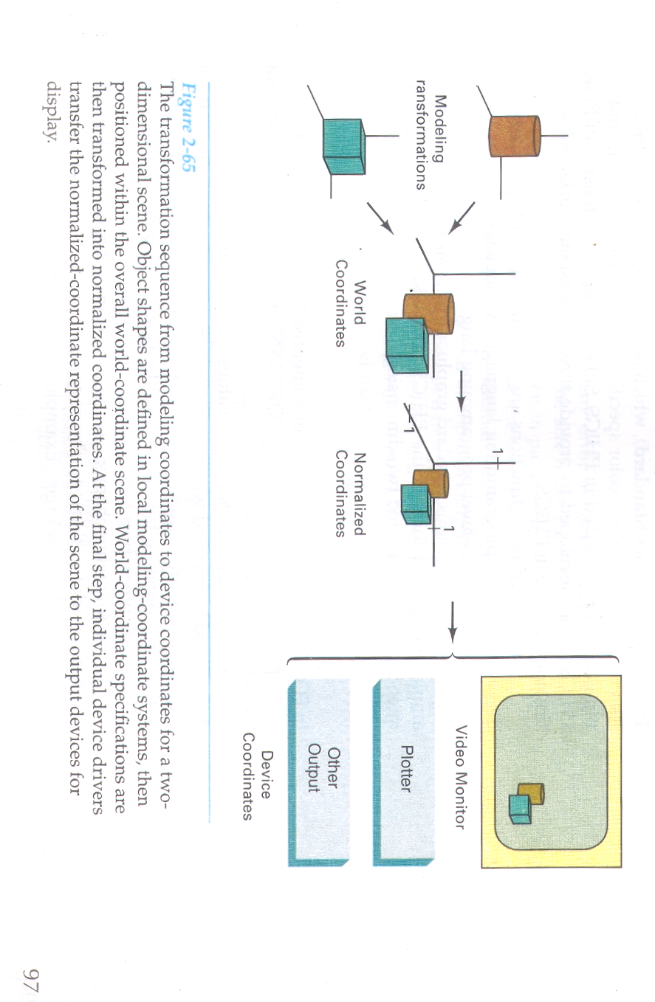

Slide 55
Graphics Functions
A general-purpose graphics package provides users with a variety of functions for creating and manipulating pictures. These routines can be categorized according to whether they deal with output, input, attributes, transformations, viewing, or general control.
The basic building blocks for pictures are referred to as output primitives. They include character strings and geometric entities, such as points, straight lines, curved Lines, filled areas (polygons, circles, etc.), and shapes defined with arrays of color points. Routines for generating output primitives provide the basic tools for constructing pictures.

Slide 56
Graphics Functions
Output primitive: The most basic shape that can be printed as an output by the output device is called as output primitive. For e.g. Point, Line, Circle.
Attributes are the properties of the output primitives; that is, an attribute describes how a particular primitive is to be displayed. They include intensity and color specifications, line styles, text styles, and area-filling patterns. Functions within this category can be used to set attributes for an individual primitive class or for groups of output primitives.

Slide 57
Graphics Functions
We can change the size, position, or orientation of an object within a scene using geometric transformations. Similar modeling transformations are used to construct a scene using object descriptions given in modeling coordinates.
Given the primitive and attribute definition of a picture in world coordinates, a graphics package projects a selected view of the picture on an output device.
Viewing transformations are used to specify the view that is to be presented and the portion of the output display area that is to be used.

Slide 58
Graphics Functions
Pictures can be subdivided into component parts, called structures or segments or objects, depending on the software package in use. Each structure defines one logical unit of the picture.
A scene with several objects could reference each individual object in a separate named structure. Routine for processing structures carry out operations such as creation, modification, and transformation of structures.

Slide 59
Graphics Functions
Interactive graphics applications use various kinds of input devices, such as a mouse, a tablet, or a joystick. Input functions are used to control and process the data flow from the interactive devices.
Finally, a graphics package contains a number of housekeeping tasks, such as clearing a display screen and initializing parameters, We can lump the functions for carrying out these tasks under the heading control operations.

Slide 60
Output Primitives:
A picture can be described in several ways. Assuming we have a raster display, a picture is completely specified by the set of intensities for the pixel positions in the display. At the other extreme, we can describe a picture as a set of complex objects, such as trees and terrain or furniture and walls, positioned at specified coordinate locations within the scene.
Shapes and colors of the objects can be described internally with pixel arrays or with sets of basic geometric structures, such as straight line segments and polygon color areas. The scene is then displayed either by loading the pixel arrays into the frame buffer or by scan converting the basic geometric-structure specifications into pixel patterns.

Slide 61
Output Primitives:
Typically, graphics programming packages provide functions to describe a scene in terms of these basic geometric structures, referred to as output primitives, and to group sets of output primitives into more complex structures. Each output primitive is specified with input coordinate data and other information about the way that object is to be displayed.
Points and straight line segments are the simplest geometric components of pictures. Additional output primitives that can be used to construct a picture include circles and other conic sections, quadric surfaces, spline curves and surfaces, polygon color areas, and character strings.
We begin our discussion of picture-generation procedures by examining device-level algorithms for displaying the two-dimensional output primitives, with particular emphasis on scan-conversion methods for raster graphics systems.

Slide 62
POINTS AND LINES:
Point plotting is accomplished by converting a single coordinate position furnished by an application program into appropriate operations for the output device in use. With a CRT monitor, for example, the electron beam is turned on to illuminate the screen phosphor at the selected location. How the electron beam is positioned depends on the display technology.
A random-scan (vector) system stores point-plotting instructions in the display list, and coordinate values in these instructions are converted to deflection voltages that position the electron beam at the screen locations to be plotted during each refresh cycle.

Slide 63
POINTS AND LINES:
For a black and-white raster system, on the other hand, a point is plotted by setting the bit value corresponding to a specified screen position within the frame buffer to 1. Then, as the electron beam sweeps across each horizontal scan line, it emits a burst of electrons (plots a point) whenever a value of 1 is encountered in the frame buffer. With an RGB system, the frame buffer is loaded with the color codes for the intensities that are to be displayed at the screen pixel positions.
Line drawing is accomplished by calculating intermediate positions along the line path between two specified endpoint positions. An output device is then directed to fill in these positions between the endpoints. For analog devices, such as a vector pen plotter or a random-scan display, a straight line can be drawn smoothly from one endpoint to the other. Linearly varying horizontal and vertical deflection voltages are generated that are proportional to the required changes in the x and y directions to produce the smooth line.

Slide 64
POINTS AND LINES:
Digital devices display a straight line segment by plotting discrete points between the two endpoints. Discrete coordinate positions along the line path are calculated from the equation of the line. For a raster video display, the line color (intensity) is then loaded into the frame buffer at the corresponding pixel coordinates.
Reading from the frame buffer, the video controller then "plots" the screen pixels. Screen locations are referenced with integer values, so plotted positions may only approximate actual Line positions between two specified endpoints. A computed line position of (10.48,20.51), for example, would be converted to pixel position (10,21). Thus rounding of coordinate values to integers causes lines to be displayed with a stairstep appearance ("the jaggies"), as represented in Fig 3-1.
The characteristic stairstep shape of raster lines is particularly noticeable on systems with low resolution, and we can improve their appearance somewhat by displaying them on high-resolution systems. More effective techniques for smoothing raster lines are based on adjusting pixel intensities along the line paths.

Slide 65
POINTS AND LINES:
For the raster-graphics device-level algorithms discussed in this chapter, object positions are specified directly in integer device coordinates. For the time being, we will assume that pixel positions are referenced according to scan-line number and column number (pixel position across a scan line). This addressing scheme is illustrated in Fig. 3-2. Scan lines are numbered consecutively from 0, starting at the bottom of the screen; and pixel columns are numbered from 0, left to right across each scan line.

Slide 66
POINTS AND LINES:
To load a specified color into the frame buffer at a position corresponding to column x along scan line y, we will assume we have available a low-level procedure of the form: setpixel ( X, Y )
We sometimes will also want to be able to retrieve the current frame buffer intensity setting for a specified location. We accomplish this with the low-level function :
getpixel (x, y )

Slide 67
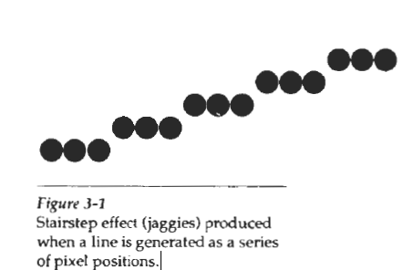
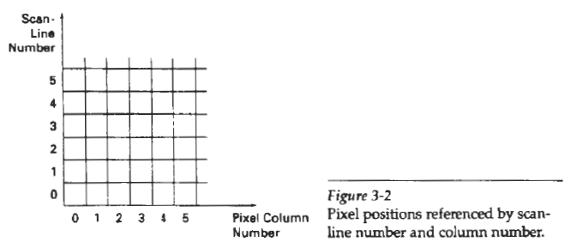
POINTS AND LINES:

Slide 68
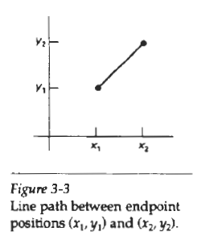
Line Drawing Algorithms
The Cartesian equation for a straight line is given by
y = m.x + b -- (1)
Where x, y are co-ordinate points, m is the slope of line, and b is known as y intercept.
Thus, value of slope for the line with two endpoints as
(X1, Y1) and (X2,Y2) is given as:
m = Y₂ - Y₁ / X₂ - X₁ -- (2)
From eqn. (1), value of b = y₁ - mx₁
Now the change in y is given by
Δy = m Δx -- (a)
Δx = Δy/m --(b)

Slide 69
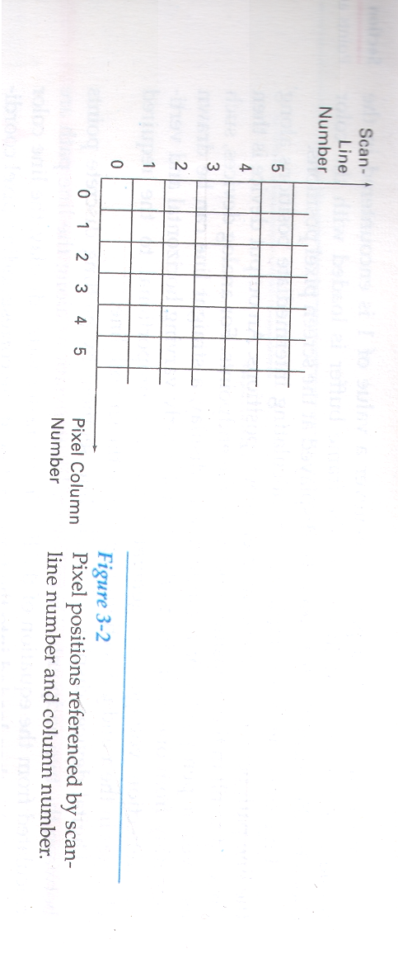
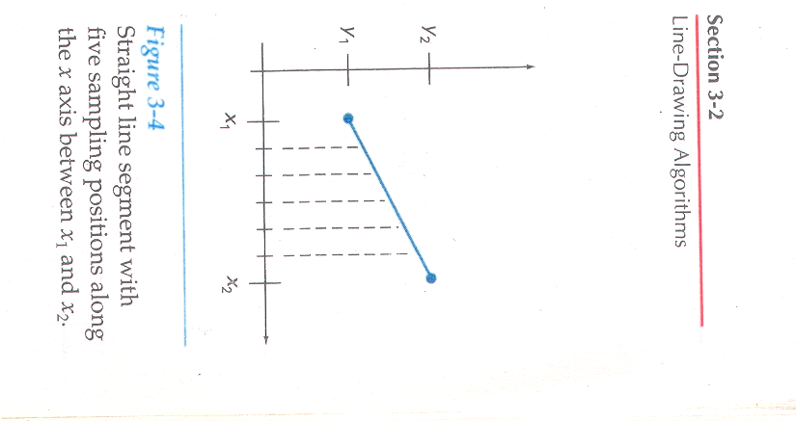
These equations form the basis for determining deflection voltages in analog devices.
On raster systems, lines are plotted with pixels, and step sizes in the horizontal and vertical directions are constrained by pixel separations.
That is, we must “sample” a line at discrete positions and determine the nearest pixel to the line at each sampled position.

